Slide 1
Capsule Network
Gaze Estimation:
Cat(both eyes, face, frame)
Reconst:
Cat(both eyes, face, frame)
Face Model
Original image
ResBasicBlock (ConvLayer)
ReLu
PrimaryCaps
Dropout
GazeCaps
(Gaze Classification)
8 labels for gaze directions
Gray Frame Model
Eye Model

Slide 2
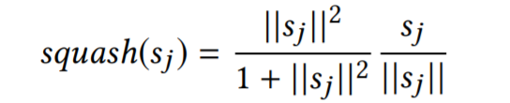
PrimaryCaps
Squash function: accept a vector and output a normalized vector with the magnitude squeezed between 0 and 1

Slide 3
GazeCaps
Dynamic Routing: find the best connections between the output of one layer of capsules and the inputs of the next layer of capsules

Slide 4
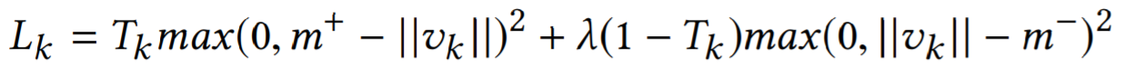
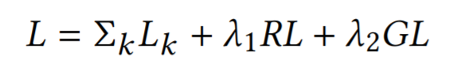
Custom Loss
Margin loss (L_k):
Reconstruction loss (RL): mean square error
Gaze Loss (GL): mean square error

Slide 5
More hyper-parameters and complicated architecture

